Slide 1

Lessons From The Jordan’s Reform Project
Adit Mahmood

Slide 2
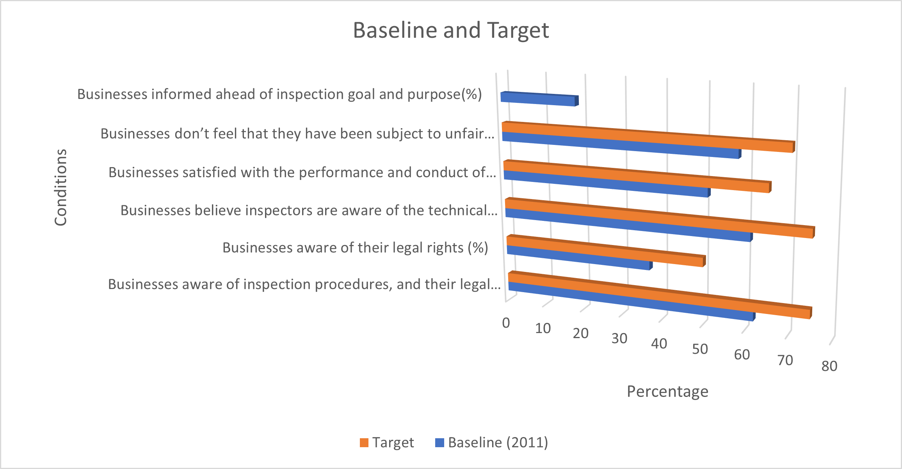
Jordanian Businesses Had Several Inspection Concerns
A 2011 survey of Jordanian businesses revealed several concerns about the quality of the inspections
Areas of concern: Biased treatment, Awareness of inspection and legal rights, frequency of visits, number of employees involved in the inspections, etc.…..
In response, the Jordanian government sought to improve the inspections regime.
The IFC project supported this project
Target values were set to assess success

Slide 3
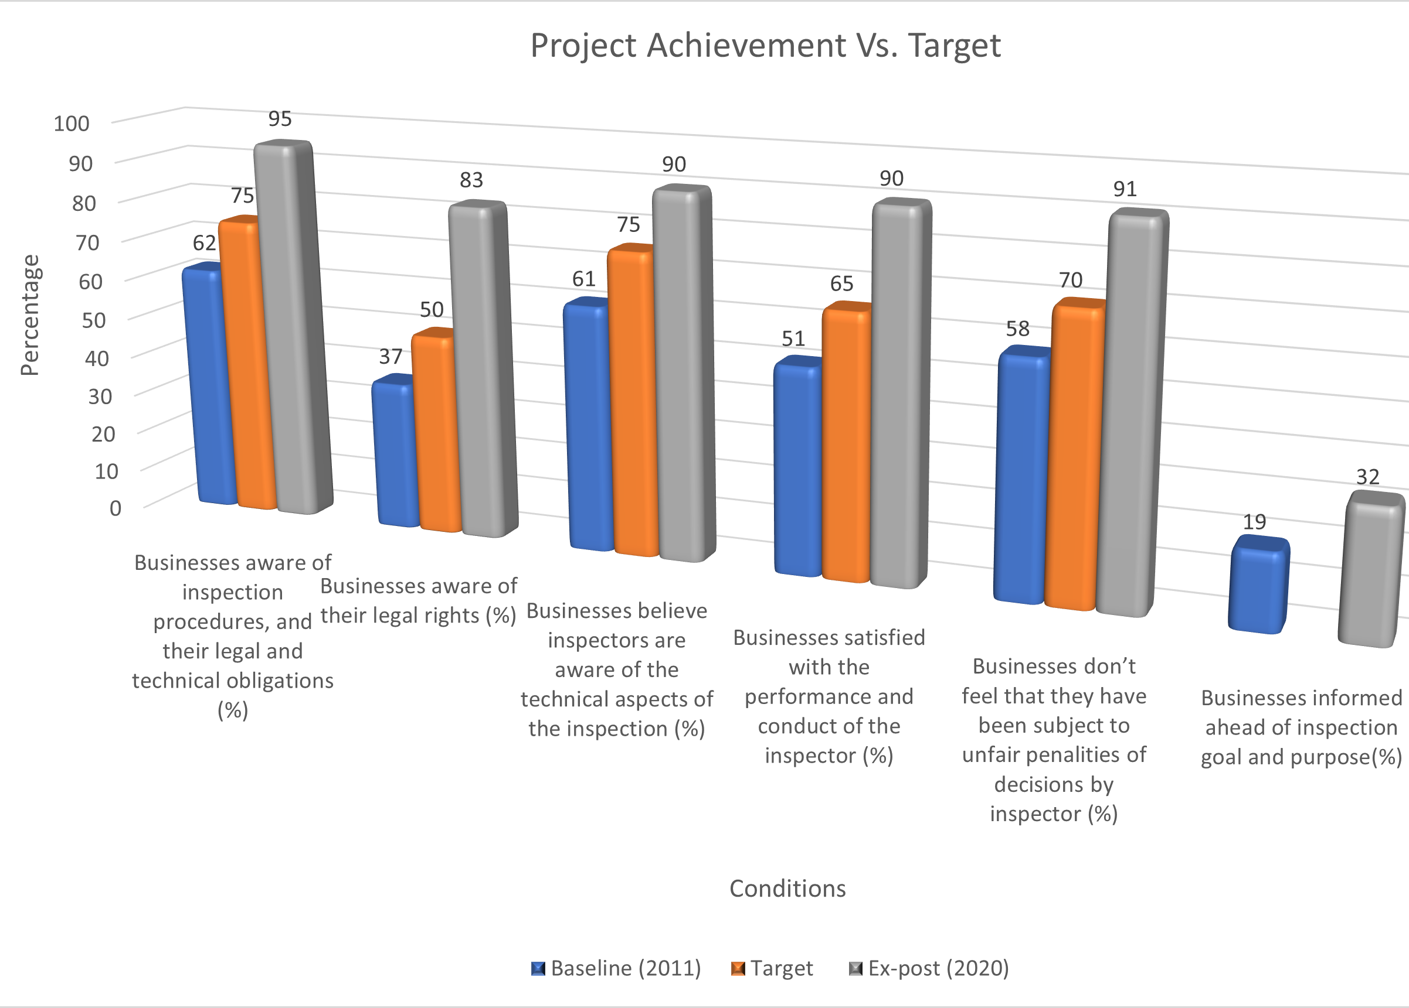
The Project Helped Improve Inspection Regime
Results exceeded target on several dimensions
However, the degree of improvement varied
Biggest improvement: Percentages of businesses aware of their legal rights
Smallest improvement: The percentage of business who felt that their inspection decisions were fair

Slide 4
What Influences Inspection Quality: Study Methodology
Best Subset Model
This step determines the best combination of factors to use for every possible number of individual components
Logistic Regression
Once the best few models were chosen, a logistic regression was used to verify the best possible one
Prediction
The best model, implied by the logistic regression, was used to generate predictions and compare these to the actual values

Slide 5
Data
Score Definition
1: Decline, 2: No Change, 3: Improvement
1: Yes, 0: No
There are two different datasets analyzed
Study 1 uses the Aggregate dataset, which looks at the change between results over time
Study 2 used the GAM dataset, which looked at data at one point of time

Slide 6
Study Description
Study 1: Aggregate Dataset
Dependent Variables: Inspector Performance and Fairness
Potential Predictors: Frequency of Visits, Fairness of Visits , Business Legal and Procedure Awareness, Inspector Awareness and Performance
Study 2: GAM Dataset
Dependent Variables: Satisfaction and Perceived Change Between Inspections
Potential Predictors: Inspection and Legal Awareness, Number of Employees, Total Employee Time, Surprise Visits, Bias, Satisfaction

Slide 7
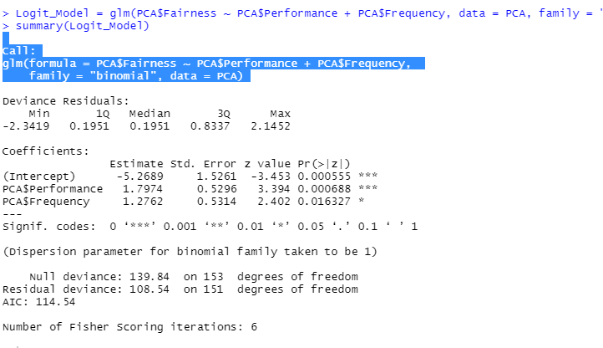
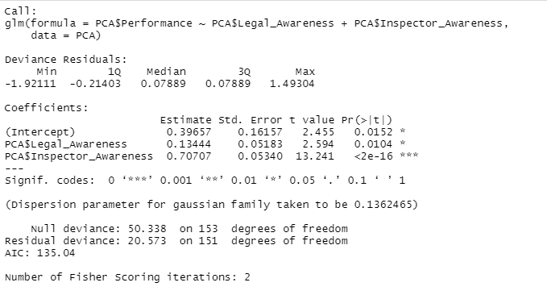
Findings of the Aggregate Dataset Analysis
Fairness
Two factors explain improvements in business perceptions of the fairness in inspection decisions I
Inspector Performance and Conduct during Inspection (This is highly significant)
Frequency of Inspection Visits
However the prediction accuracy for this model was not very high
Inspector Performance and Conduct in turn is influenced by two awareness factors:
Inspector Awareness of the Technical Aspects of the Inspection (This was very significant)
Business awareness of their legal rights
The prediction accuracy was high

Slide 8
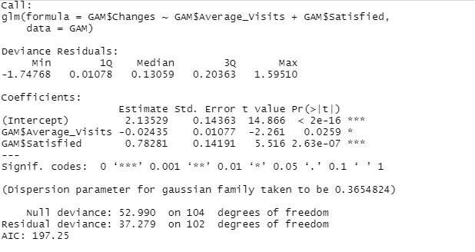
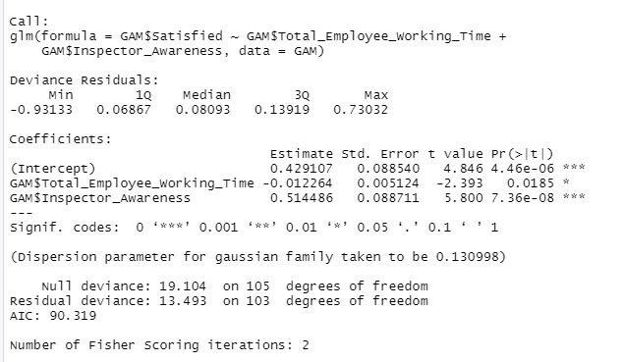
Findings of the GAM Dataset Analysis
Business perceptions about inspection quality would improve if:
The number of satisfied businesses regarding the performance and conduct of inspectors during the inspection
A reduction of the average number of visits
The prediction accuracy of this model is high
Businesses are more satisfied with the performance and conduct of inspectors when:
The inspectors are more aware of the technical aspects of the inspection
Less employee time was spent during the inspection
The prediction accuracy of this model is high

Slide 9
Policy Implications
It is clear from the analysis that more businesses would be satisfied if there was better planning and coordination between government agencies. A few of the factors that appear to be significant can be connected to the number of employees involved in the inspection, which appears to be excessive in a few situations. Reducing the number of employees involved in the inspection would also decrease the duplication of visits, an issue that can have a harmful effect on the inspections.
One area where inspectors can help themselves is to improve their own behavior. While variables such as bias have a significant effect, factors that have a bigger impact include advancing the knowledge of the technical aspects. If inspectors paid a little more attention to this aspect, then the perception, quality and performance of the inspections should increase over time.
Another conclusion from the findings is that the businesses should become more aware of their legal rights because it would allow them to improve the inspection process on their end.

